Slide 1


Siamese Networks and Image Verification
Emanuele Alessi
Gianmarco Forcella
Taranciuc Gabriel

Slide 2

Siamese networks
Notes:
Why Adam:
It is easy to implement;
It is computationally efficient;
It requires a small amount of memory;
It is invariant to the diagonal rescale of gradients.

Slide 3
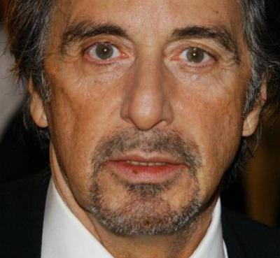
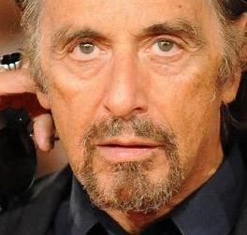
Siamese networks (face verification)
Si
Siamese Network
No
Notes:
Why Adam:
It is easy to implement;
It is computationally efficient;
It requires a small amount of memory;
It is invariant to the diagonal rescale of gradients.

Slide 4
Classification vs One-shot learning
Al Pacino
Siamese Network
Classification
Al Pacino
Feature vector 1
One-shot
learning
Siamese Network
Feature vector 2
Notes:
Why Adam:
It is easy to implement;
It is computationally efficient;
It requires a small amount of memory;
It is invariant to the diagonal rescale of gradients.

Slide 5
One-shot learning
Capacità di classificare un oggetto senza doverlo vedere migliaia di volte
Training set con un ridotto numero di samples
Gli embeddings vengono generati in modo più accurato
Con l’aggiunta di nuovi samples il modello non dev’essere riaddestrato
Notes:
Why Adam:
It is easy to implement;
It is computationally efficient;
It requires a small amount of memory;
It is invariant to the diagonal rescale of gradients.

Slide 6
Convolutional Neural Network
4096
Flatten 1 + Fully connected
32 filters
64 filters
64 filters
128 filters
Conv2D
+
Max-pooling
Conv2D
+
Max-pooling
Conv2D
+
Max-pooling
Conv2D
+
Max-pooling
4096
Flatten 2 + Fully connected
4096
Flatten 1 + Fully connected
4096
4096
1
L1 distance
Fully connected
Similarity score
4096
Flatten 2 + Fully connected
Notes:
Why Adam:
It is easy to implement;
It is computationally efficient;
It requires a small amount of memory;
It is invariant to the diagonal rescale of gradients.

Slide 7

Loss function
Sigmoid cross entropy
Notes:
Why Adam:
It is easy to implement;
It is computationally efficient;
It requires a small amount of memory;
It is invariant to the diagonal rescale of gradients.

Slide 8

TensorFlow
Libreria open source per il Machine Learning
Sviluppata da Google
Computazione molto efficiente
Notes:
Why Adam:
It is easy to implement;
It is computationally efficient;
It requires a small amount of memory;
It is invariant to the diagonal rescale of gradients.

Slide 9
Allenando la rete Siamese
Dal dataset ai dati di training al processo di training

Slide 10
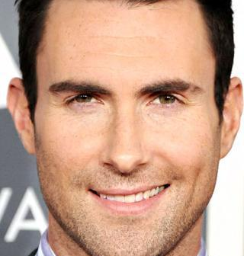
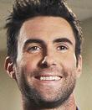
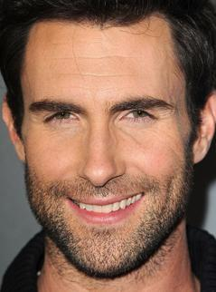
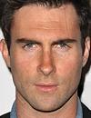
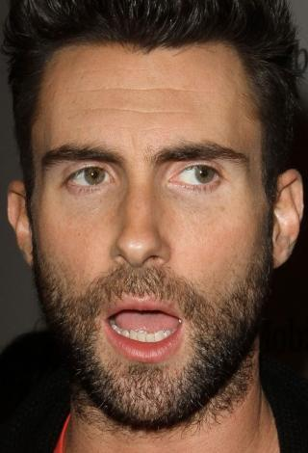
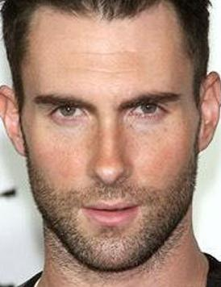
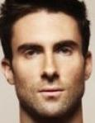
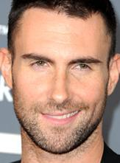
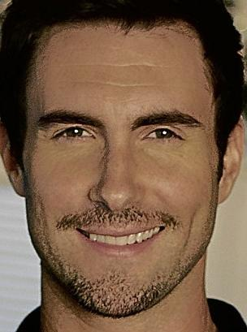
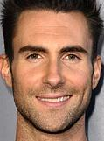


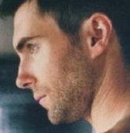
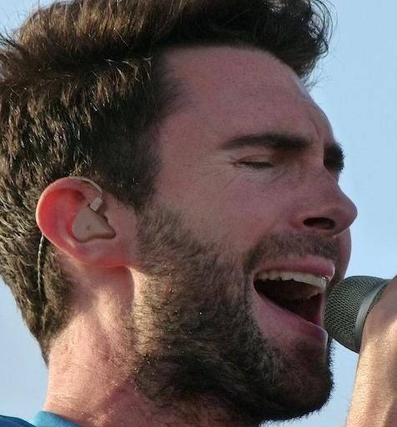
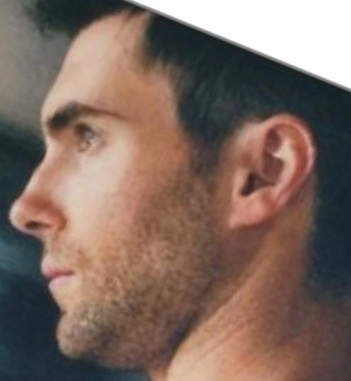
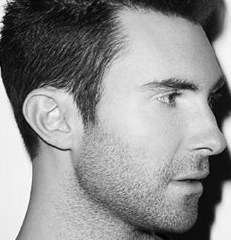
Il dataset CFPW
Un dataset contenente 500 celebrità, con 14 fotografie per ognuna, 10 frontali e 4 di profilo.
Dimensioni, aspet ratio, condizioni di luce ed espressioni differenti per ogni imagine.
Per i nostri scopi, abbiamo deciso di utilizzare soltanto le immagini frontali.

Slide 11
Caricamento e splitting
Tutte e 10 le immagini frontali vengono caricate in memoria attraverso PIL
Le immagini vengono in seguito ridimensionate a 105x105 attraverso la tecnica LANCZOS
Vengono infine selezionate randomicamente il 70% delle immagini di ogni persona per il training, e viene lasciato il restante per il testing

Slide 12
Allenamento con TensorFlow
Tutte le immagini vengono convertite in array NumPy di dimensioni 105x105x3 per uso su TensorFlow
Ad ogni iterazione, la rete viene allenata con una batch di 32 coppie di immagini prese a caso dal train set:
16 coppie “vere”
16 coppie “false”
Lo scopo finale è quello di minimizzare la loss → Adam Optimizer
Notes:
Why Adam:
It is easy to implement;
It is computationally efficient;
It requires a small amount of memory;
It is invariant to the diagonal rescale of gradients.

Slide 13
Test dell’accuracy in training
Ogni 500 passi
Eseguito su un support set di 10 coppie prese dal test set:
1 coppie “vera”
9 coppie “false”
Si vede se la coppia “vera” è stata classificata come la più simile o meno

Slide 14
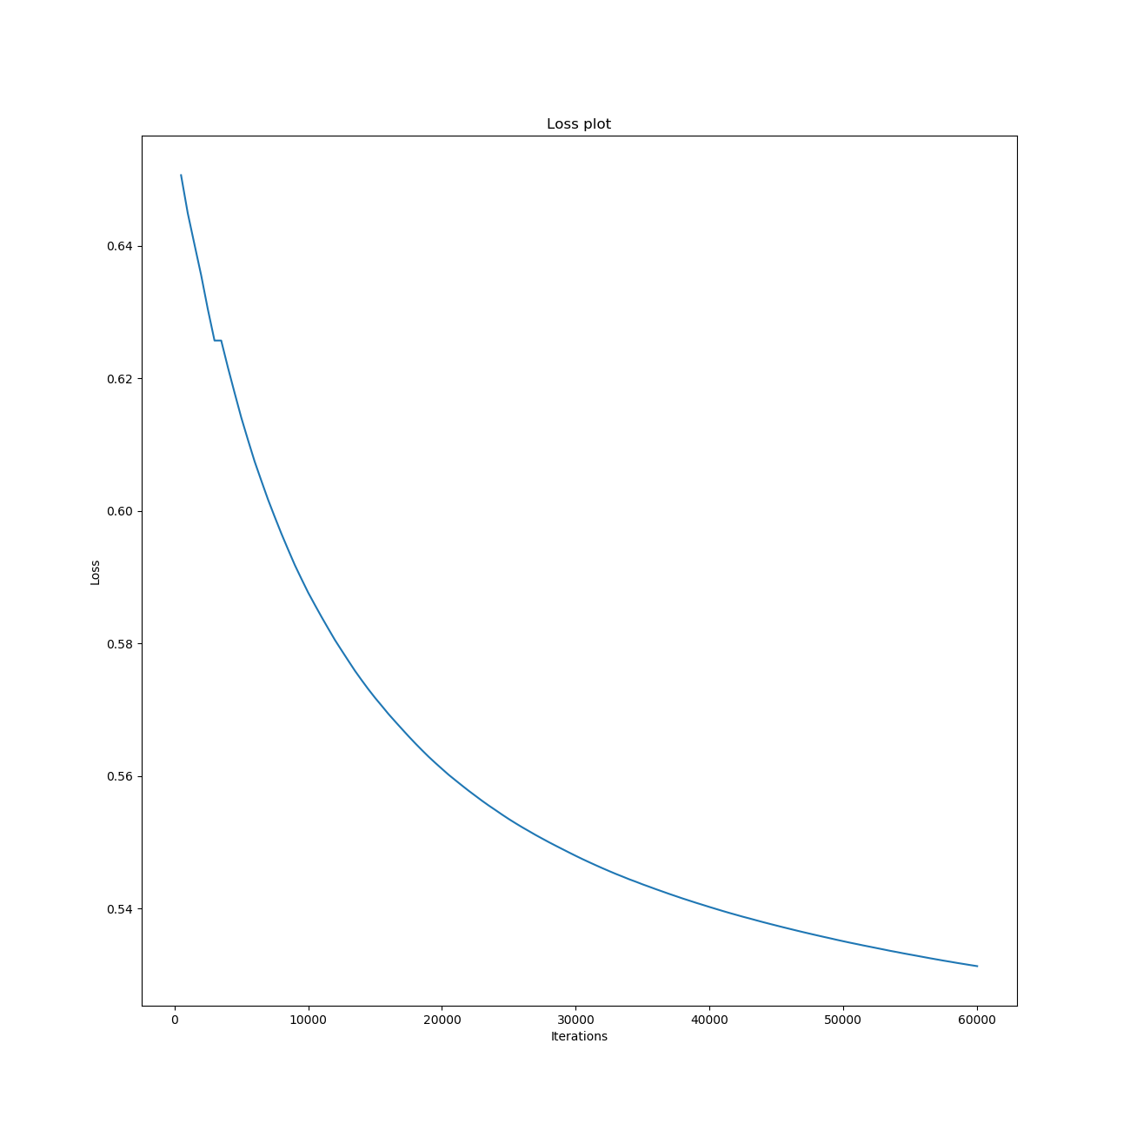
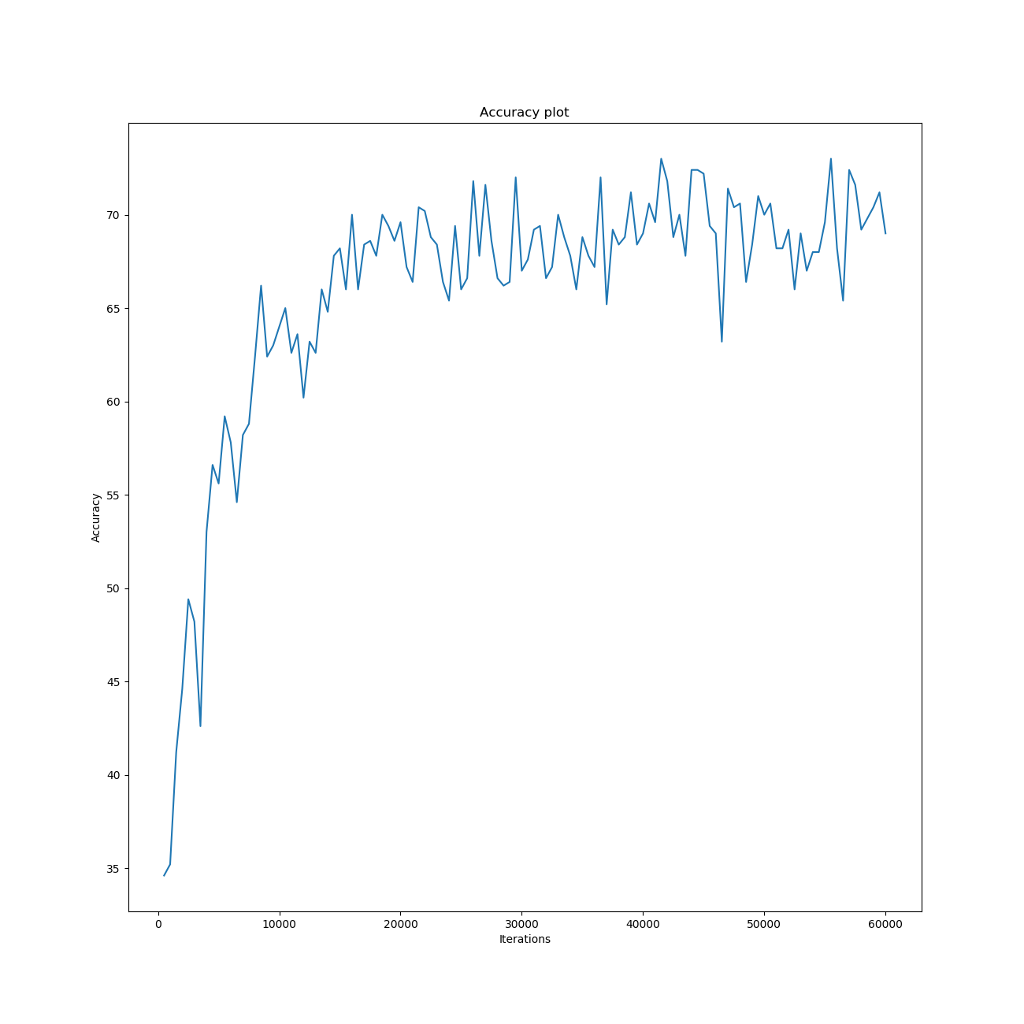
I nostri risultati di allenamento
Dopo un totale di 60000 iterazioni, la loss del nostro sistema è decrementata drasticamente, mentre l’accuracy si è stabilizzata intorno ad un valore di 70%

Slide 15
Testing the Network on the wild
Usually, there are two ways for testing Convolutional Neural Networks on the wild:
Closed Set, meaning that the Network will receive as an input images that are somehow known to the dataset (hence, to the network as well);
Open Set, meaning that our network could be tasked to also evaluate samples of users which are not registered in the dataset
Our focus will be on the Verification with Multiple Templates: this means that the network will have to make a match of a person against his/her stored templates on the dataset

Slide 16
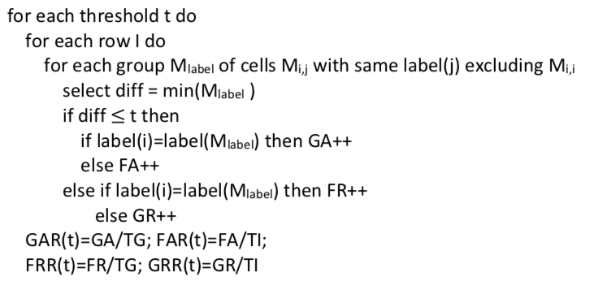
The operation will be implemented according to the «One vs All» procedure, so that it is possible to have a better accuracy value.

Slide 17
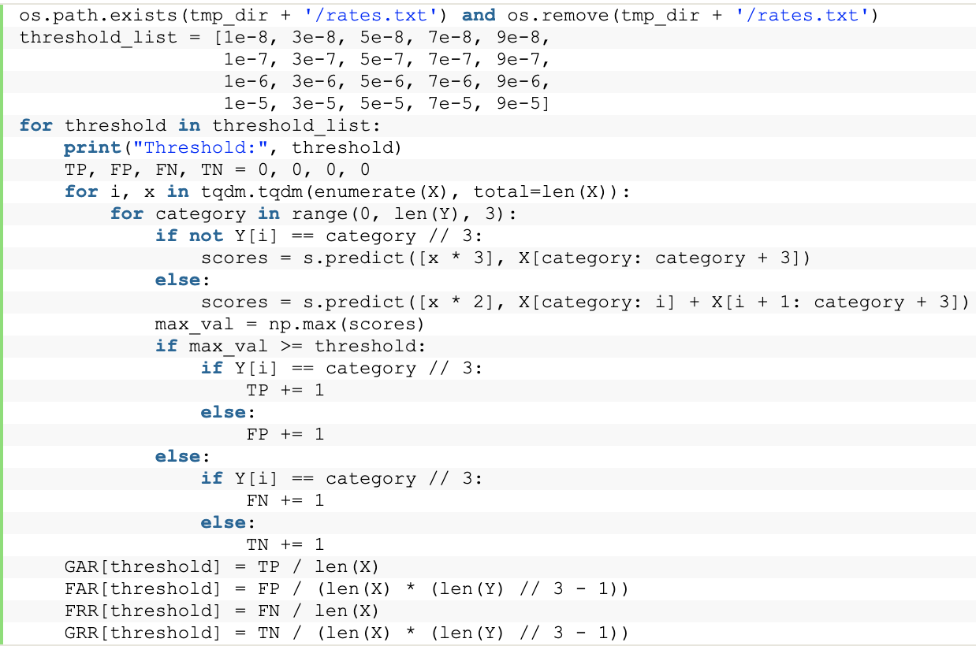
Python implementation of One vs All with Siameses Neural Networks

Slide 18
Algorithm’s explanation
By iterating on the test set, we take 3 images (3 of, say, a person X if X is not the person we are using to make the comparison; 2 otherwise) that will be compared to the one currently analyzed:
The Siamese Network will then perform its predictions
If one of these three predicted values are greater or equal to the current threshold, then it is safe to assume that we have a positive prediction.
This will be either true or false, based on the matching of the compared identities. The same holds true if the prediction is negative

Slide 19
AWS for more power
Since a consumer-grade computer would have taken a lot of time, we decided to use an AWS’s p2.xlarge instance
With this, the calculation took only 9 days instead of 20.
The specs of a p2.xlarge instance are as follows:
61GB of RAM
4 vCPUs
1 nVidia K80

Slide 20
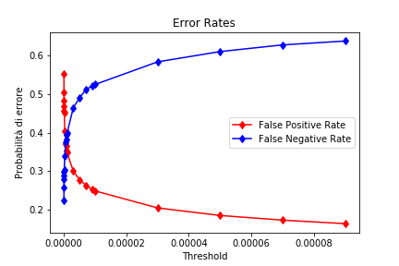
FAR and FRR mutation during time
After the calculations, this is how FAR and FRR evolves through time
Since we are using the One vs All Procedure, we need to find the E.R.R. which, according to the plot, is between 0.37 and 0.38

Slide 21
Conclusions
Adapted a network that was initially created for handwriting recognition to image recognition.
As for future work, it might be interesting to try to tweak the network in order to reach an accuracy value of 75%-80% or more.
Data augmentation to get more accuracy

